Slide 1
Spellchecker
David Pick, Sean Kriesberg, Ross Hansen

Slide 2
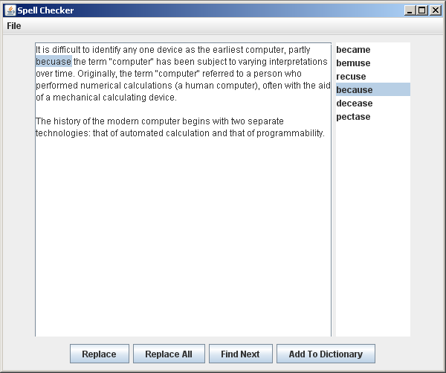
General UI Philosophy
Notes:
Talk about how the user interface is set up

Slide 3
Dictionary Class
HashSet stores all words in the dictionary
loadDictionary(String fileName) to load dictionaries
Loading words from multiple dictionary files easy
Distance(str, str) computes the “distance” between two strings
Used to generate suggestions

Slide 4
Displaying the Text
TextPanel class
Contains a JTextArea to show the text
A JList shows the suggested words
Highlights misspelled word as user traverses misspelled words
“Parallel” ArrayLists keep track of what words are misspelled and where they are in the JTextArea
Notes:
“parallel” in the sense that the same index is used in both ArrayLists to refer to a certain word

Slide 5
Generating Suggestions
For a certain misspelled word, loop through every word in the dictionary and compute “distances”
Distances calculated with “Levenshtein Distance” algorithm
Words within a certain threshold are added to the suggestions list
Works fairly well, although can be slower for large dictionaries and generally finds many suggestions for shorter words

Slide 6
Replacing Misspelled Words
Once suggestions are generated and displayed
The user is able to select one
Then the misspelled word is replaced in the text and removed from the array of misspelled words
The user also has the option to replace all or add to dictionary

